Slide 1
BIOMEDIN 215 Data Science in Medicine
Nigam Shah, MBBS, PhD
nigam@stanford.edu

Slide 2
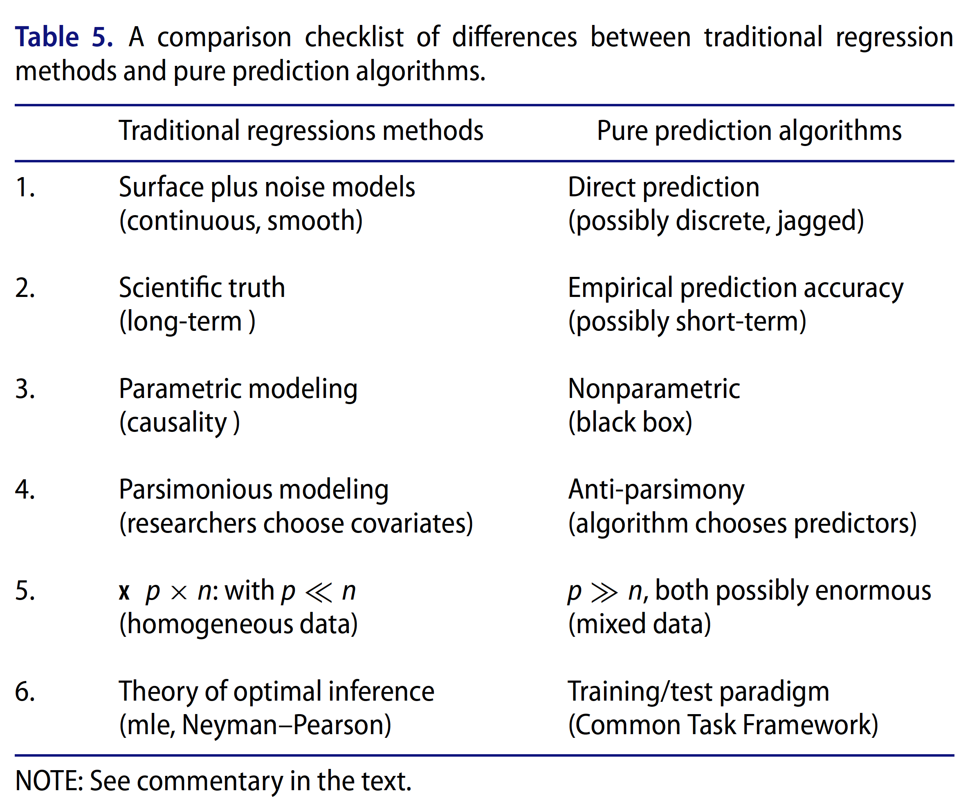
Recall: the two cultures

Slide 3
Decide whether to act
Predominantly Predictive
Causality optional
If (Risk > Th.)
then (do = X)
Predominantly Inferential
Causality matters
Guide choice of how to act
Notes:
Mention “digital biomarkers” (e.g. typing speed as a proxy for alzheimers)

Slide 4
Are we asking the right questions? Does any of this matter? How will this evidence be used in practice?
Preventing Type 3 errors!

Slide 5
Population level vs. personalized analysis
Is X associated with Y in patients with Z?
The usual analysis
If I get X, what is the risk of Y for me?
summarize the rate of Y
predict the risk of Y
tell me what happens if I do not get X
Check out http://greenbutton.stanford.edu

Slide 6
Goals for today
Understand the relationship b/w risk scores and predictive models
De-mystify supervised learning algorithms
Search space, loss function, search strategy
Use of out-of-sample errors to assess models
List commonly used model types
Notes:
Lecture 13 – Causal Analyses
Lecture 14 – Journal Club
Lecture 15 – Deep learning
Two new lectures on “Beyond Predictions”
Prediction action coupling
The need for interpretability
Ethics, Utility, Work Capacity
Legal implications

Slide 7
Risk scores and Models

Slide 8
Example: APACHE III
A 56 year old woman with acute leukemia is admitted to the ICU from her hospital room following an episode of aspiration pneumonia. She had not been treated in the ICU during this hospitalization.
Notes:
Acute Physiology and Chronic Health Evaluation, 1981
Collected data from the first 24 hours
Multivariate Logistic Regression
Chronic Status: Letter
(Best) A; B; C; D (Worst)
APACHE II: 1985
APACHE III: 1993
APACHE IV: 2006
Apache II is the oldest system still in common use
Slightly inferior to more modern scores in discrimination
Simplified compared to the original APACHE
From 34 to 12 variables
Reweighted
http://journals.lww.com/ccmjournal/Abstract/2006/05000/Recalibration_of_risk_prediction_models_in_a_large.13.aspx

Slide 9
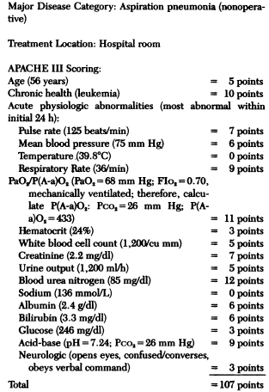
APACHE III First day risk equation
Sum all points: 107
Scale by a fixed constant (0.0537): 5.7459
Consider additional factors
Aspiration pneumonia: -4.5575
Hospital floor admission: 0.2744
Log odds of death:
5.7459 + (-4.5575) + 0.2744 = 1.4628
Log(r/(1-r)) = 1.4628
Probability of death = 0.812

Slide 10
ASCVD risk estimator
335 calculators on MDCalc.com

Slide 11

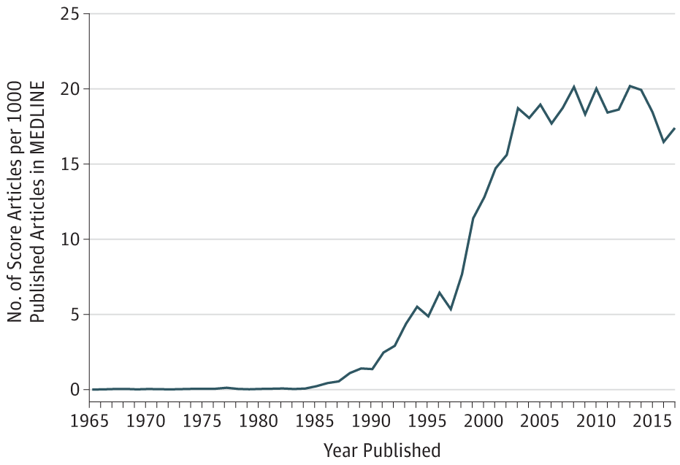
From: The Proliferation of Reports on Clinical Scoring Systems: Issues About Uptake and Clinical Utility
JAMA. Published online May 24, 2019. doi:10.1001/jama.2019.5284
Notes:
Eg. ROMA score, VeriSrat (bu Biodesix)
Assumptions of Scoring: Severity of acute diseases can be quantified based on physiological measurements
Four broad categories of scoring systems:
General risk-prognostication systems
Prognosis for specific disease
Trauma scoring
Organ failure scoring

Slide 12
Demystifying Models

Slide 13
Supervised Learning
features
(e.g. patient characteristics)
target
(e.g. patient outcome)
X_{new}
f(X)
Learning Algorithm
Model
observations
(e.g. patients)
X
y
y_{pred}
“Training Data”
We implicitly assume there is a real “data generating function”, which is unknown and is what we are trying to model
Notes:
how does this happen?

Slide 14
What is a predictive model?
y
model error
y_{pred}
model function m(x)
noise
residual
training data
data-generating function f(x)
x
x_{new}
Notes:
italics are entities that you can’t measure
non-italics are measured entities

Slide 15
The components of a learning algorithm
All models (functions)
Search space: what are the possible models to consider? (a set of functions)
Loss : given the data, how good do we consider each possible model? (a function of the model and the data)
Search strategy: how will we search the space of possible models to find the best one? (an algorithm)
search space
credit to Jerome Friedman (STATS 315B) for this framework

Slide 16
Example: Linear Regression
y
Search Space | linear functions
Loss | sum of squares of residuals
Search Strategy | analytical solution or convex optimization
x

Slide 17
The Search Space
All models (functions)
Search space: what are the possible models to consider? (a set of functions)
Loss: given the data, how good do we consider each possible model? (a function of the model and the data)
Search strategy: how will we search the space of possible models to find the best one? (an algorithm)
search space
credit to Jerome Friedman for this framework

Slide 18
You have a dataset with 10 people who were admitted to the ER. Some of them later got sepsis in the ICU. You want to use that data to predict whether a new patient coming to the ER will get sepsis, later in the ICU.
Sweet spot?:
good accuracy on training data
similar answers for every training dataset
conservative learning
aggressive learning
Learning algorithm 1:
Always predict whatever the majority outcome was in the training data
Learning algorithm 2:
Find the most similar patient and predict whatever happened to that person will happen to the new patient
not very accurate on the training data
will usually get a similar model every time
perfectly accurate on the training data
will get very different models depending on the training data
Worth with a colleague and take one minute to argue for why it would be better than the other at predicting whether a new patient is at risk for sepsis- what are the problems with your partner’s learning algorithm?

Slide 19
Bias – Variance trade off
Figure 1. Bias and variance in dart-throwing.
Domingos 2012, Com. of the ACM, Oct 2012, Vol. 55, No. 10.
Notes:
ROCs give you the probability that the ‘measure’ is higher for a case than for a non-case.
So if a survival score assigned 0.52 for case and 0.51 for non-case, the c-statistic would be perfect.
ROCs tell you nothing about whether a person with a higher score will eventually become a case.
Tie this to the need to look beyond the AUC, and examine PR curves as well as calibration.

Slide 20
The Loss Function
All models (functions)
Search space: what are the possible models to consider? (a set of functions)
Loss: given the data, how good do we consider each possible model? (a function of the model and the data)
Search strategy: how will we search the space of possible models to find the best one? (an algorithm)
search space
credit to Jerome Friedman for this framework

Slide 21
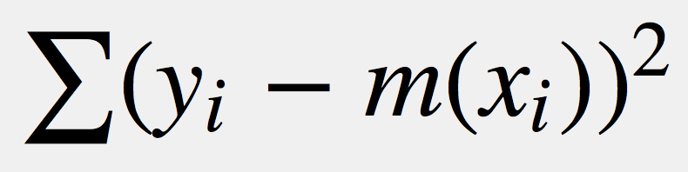
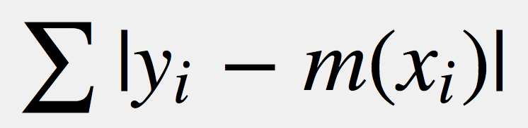
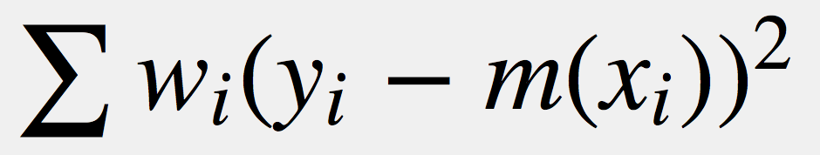
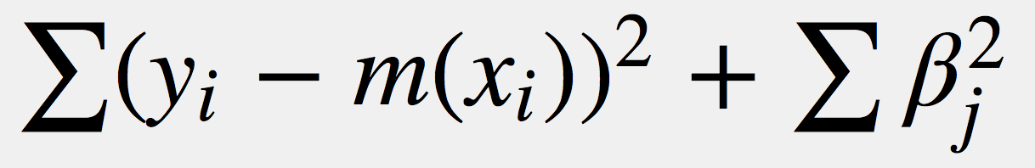
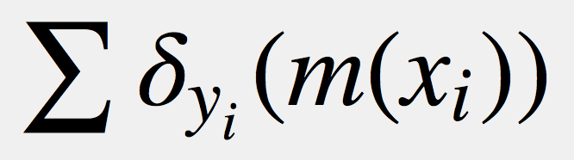
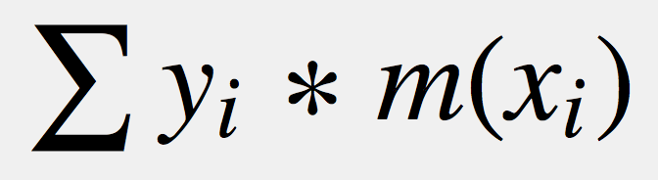
Losses compare predictions to observed outcomes
squared error
absolute error
Regression
weighting
penalizing model parameters
misclassification
Classification
classification distance
Notes:
Different loss functions determine how much the learning algorithm cares about different sizes of training errors.
Absolute (linear) losses equally weigh one big error and many small errors, while strictly convex losses (e.g. quadratic) emphasize big errors more than small errors.

Slide 22
y
x
These are the best-fit lines from two different learning algorithms. Both have the same search space (linear functions), but they may use different loss functions.
Which is the fit using a squared-error loss? Which is the fit using absolute (linear) loss?
think-pair-share
Notes:
If there is still uncertainty, ask for someone who is confident in their answer to come to the board to explain

Slide 23
The Search Strategy
All models (functions)
Search space: what are the possible models to consider? (a set of functions)
Loss: given the data, how good do we consider each possible model? (a function of the model and the data)
Search strategy: how will we search the space of possible models to find the best one? (an algorithm)
search space
credit to Jerome Friedman for this framework

Slide 24
Other Search Strategies you may hear of:
Stochastic gradient descent
Expectation Maximization (EM)
Monte Carlo methods (e.g. Gibbs Sampling)
Genetic Algorithms
Notes:
these are the CS things that

Slide 25
Model Selection and Evaluation
Notes:
Train, test, validation set
Train, tune, held out test set.

Slide 26
features
(e.g. patient characteristics)
target
(e.g. patient outcome)
training error
observations
(e.g. patients)
Learning Algorithm
Training Data
m(x)
Test error
Test Data
Splitting our data into training and test sets lets us see how our model will perform in the wild

Slide 27
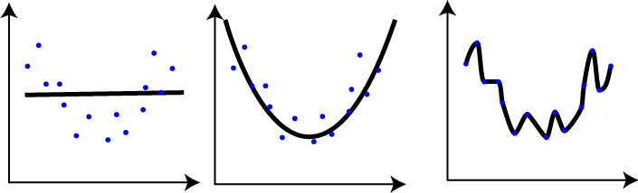
Pick the model that has the lowest test error
How well does it fit training data?
Model A
Model B
Model C
How well does it fit test data?
Notes:
High-bias/low-variance learners often underfit
Low-bias/high-variance learners often overfit

Slide 28
Most often you are selecting between several models that were produced by varying a parameter within a particular learning algorithm (e.g. λ in regularized regressions)
test error
error
training error
Model A
Model B
Model C
conservative learning
(small search space)
best
aggressive learning
(large search space)
Model Complexity

Slide 29
If we don’t have too much training data to begin with, we can’t afford to split off a large chunk of it. What do we do for model selection then?

Slide 30
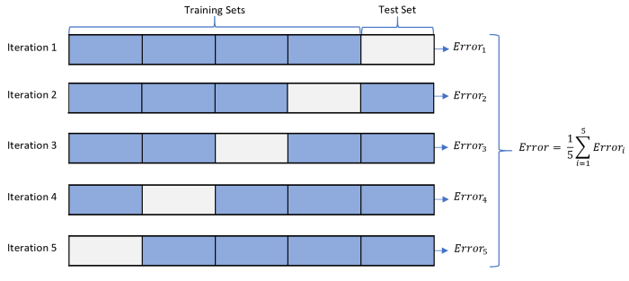
Solution: Cross-Validation
Repeat the test/training procedure over each of these different splits
Credit: Rebecca Patro - https://towardsdatascience.com/cross-validation-k-fold-vs-monte-carlo-e54df2fc179b

Slide 31
mean cross-validation error
error
mean training error
conservative learning
best
aggressive learning

Slide 32
Besides helping us select a model, cross-validation also gives us an idea of what our model’s error will be on new data

Slide 33
Pros and Cons of a few common model types

Slide 34
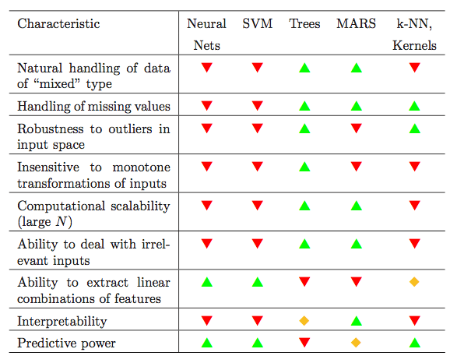
GLMs
Tree Ensembles
Mixed data, missing values, outliers, ad-hoc transformations, and irrelevant inputs are rare in pictures of cats, but they are abundant in clinical data!
Take Stats 315a. Modern Applied Statistics: Elements of Statistical Learning to learn in depth
from Elements of Statistical Learning
Notes:
GLMs are regularized regressions
tree ensembles include random forests and gradient boosted trees

Slide 35
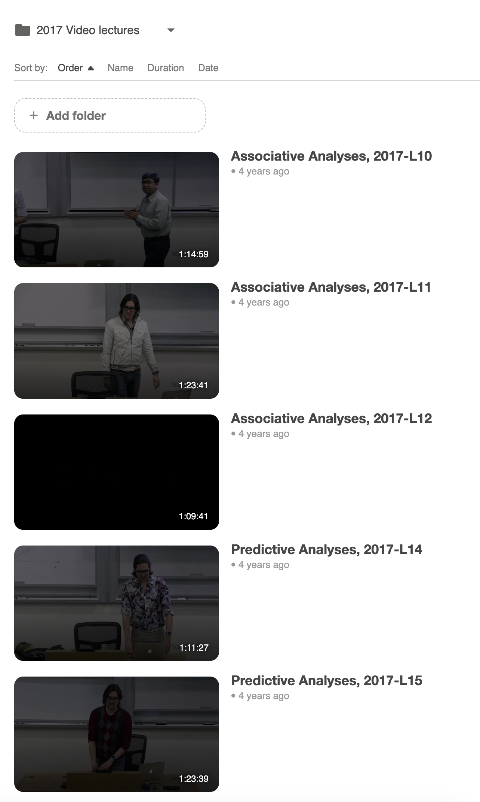
Videos that cover methods details
Associative Analyses lectures from 2017 (mentioned in lecture 12)
Predictive Analyses lectures from 2017 (mentioned in lecture 15)

Slide 36
Assigned viewing
Predicting delayed wound healing, 2018 – 60 min video lecture.
This is the equivalent of “how to not be wrong” lecture for associative analyses.

